Slide 1
How can (weak) local leaders co-create healthy urban development?
Sarah Ayres, Andrew Barnfield (University of Bristol), Mark Sandford (House of Commons Library), Geoff Bates (University of Bath)
Notes:
INSTRUCTIONS
Font should be set to Arial throughout the presentation.
Title Slide heading should be between 36 and 44 font size.
Time/Date and subtitle (below heading) should be in size 11. Time/Date should also be in bold, as per below example:
14:45-15:45, 21st Oct ’21
Panel Discussion: Healthy Places and the Future of Private Sector Involvement
To add/remove or adjust the positioning of logos, go to ‘View’, then ‘Slide Master’ and edit here. Please note the changes made in the Slide Master will apply throughout the presentation. Ensure an original copy of the Powerpoint is kept safe.

Slide 2
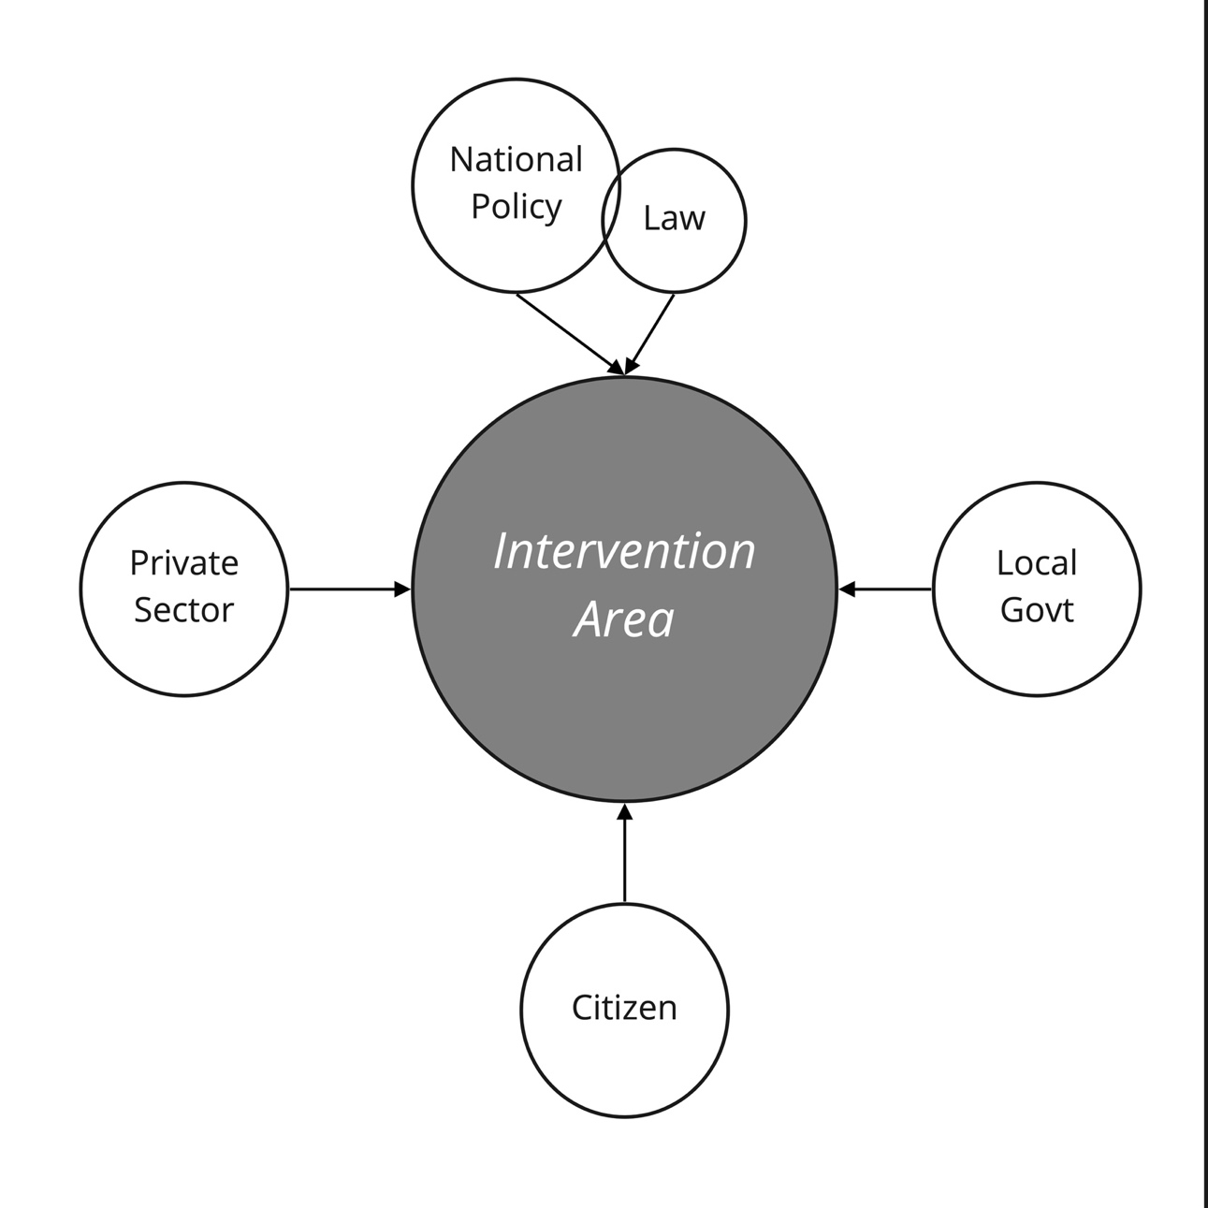
Phase 1 / Yrs 1-2
Phases 2-3 / Yrs 3-4
6 work packages
Mapping & Understanding
Intervention co-production
(& evaluation)
Primary Engagement
(interviews, workshops)
Economic Valuation
Public Involvement

Slide 3
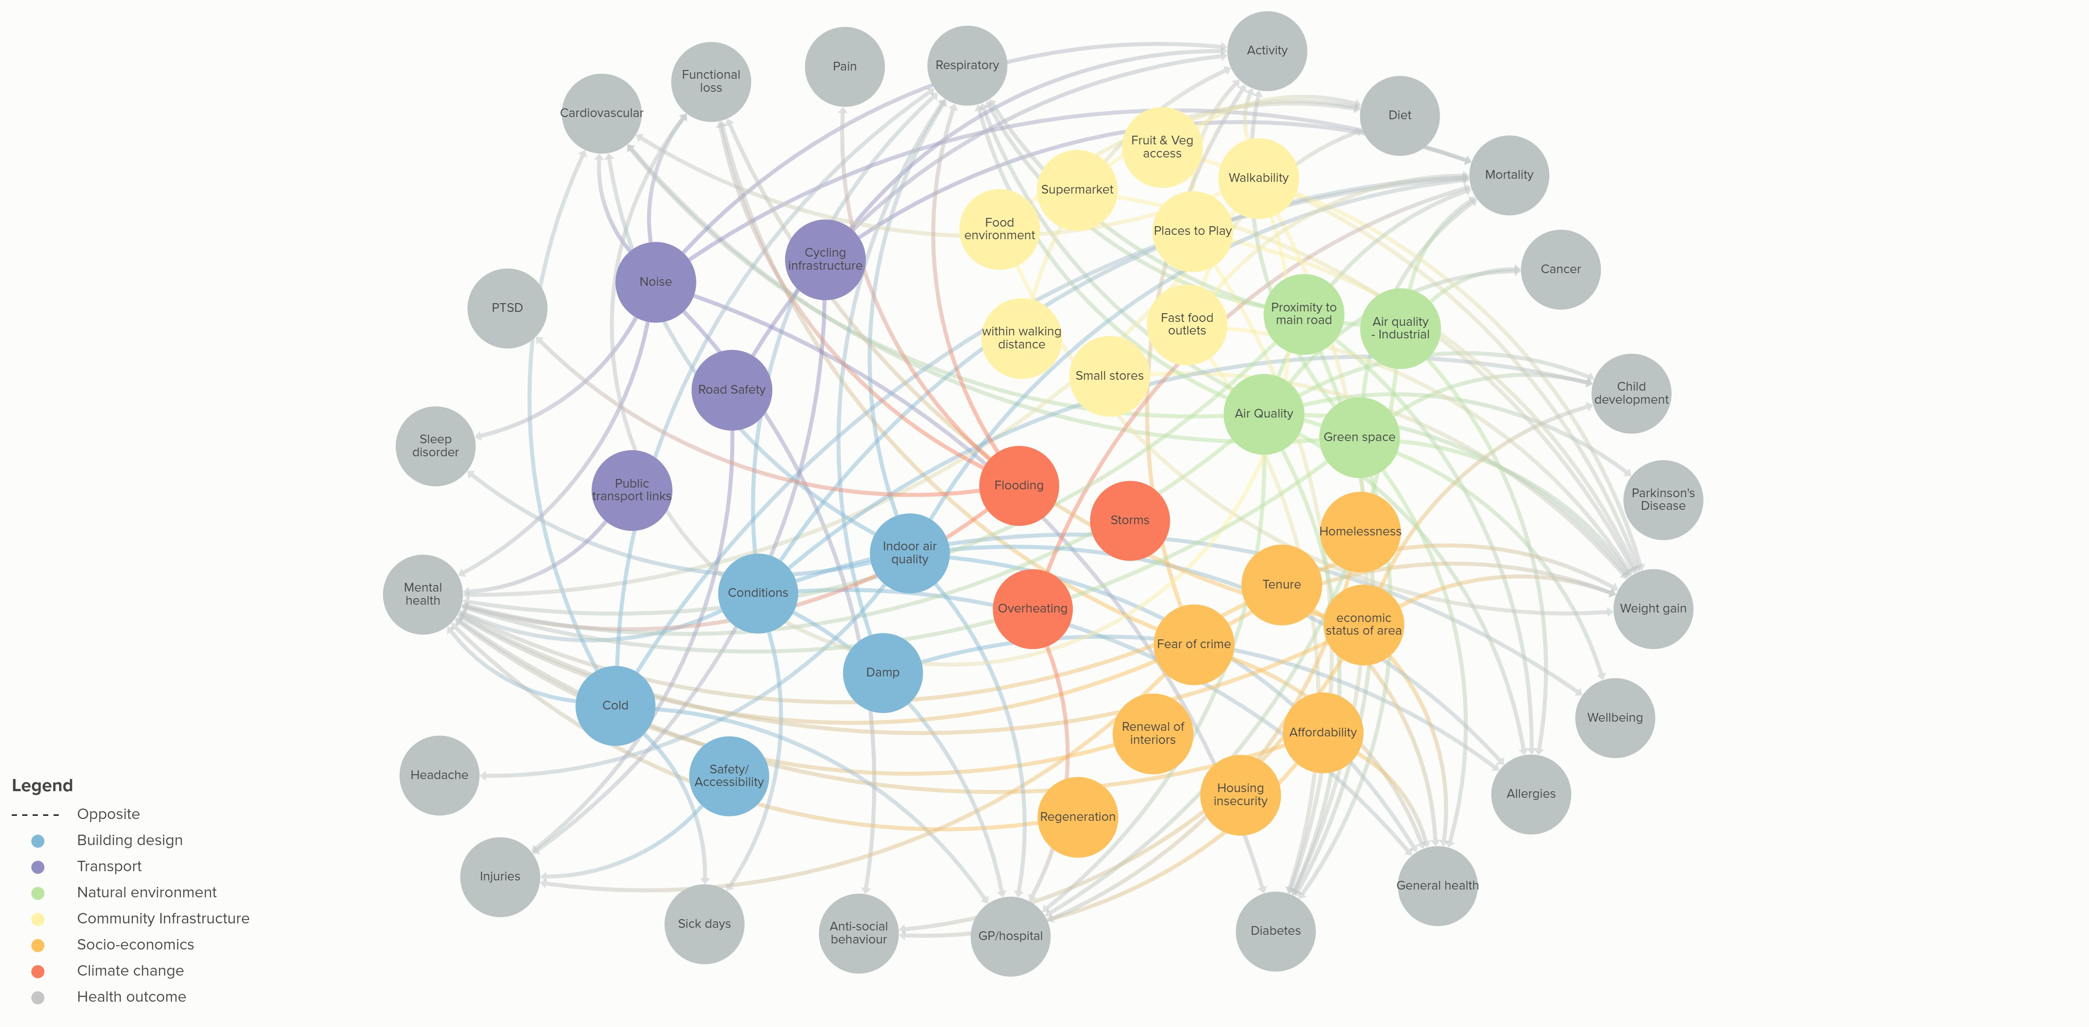
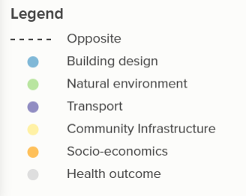
Health impacts related to the urban environment
Derived from Ige-Elegbede et al, (2020)
Notes:
Full reference is: Ige-Elegbede, J., Pilkington, P., Orme, J., Williams, B., Prestwood, E., Black, D. and Carmichael, L., (2020) Designing healthier neighbourhoods: a systematic review of the impact of the neighbourhood design on health and wellbeing. Cities & Health, pp.1-16. Available from: https://www.tandfonline.com/doi/full/10.1080/23748834.2020.1799173

Slide 4
Who pays for poor health?
Employers
NHS, Medical
Income
Life years
Time
Pain and suffering
Social care
Care for others
Family
Education
Taxation
Crime and Justice
State

Slide 5
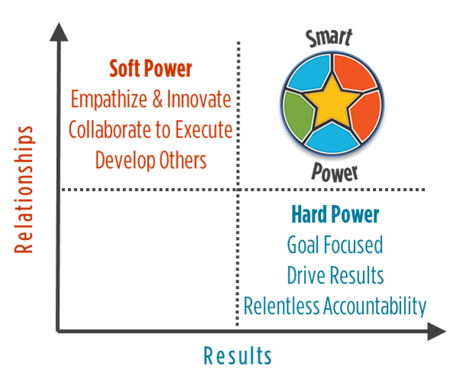
What role for England’s Mayors?

