Slide 1
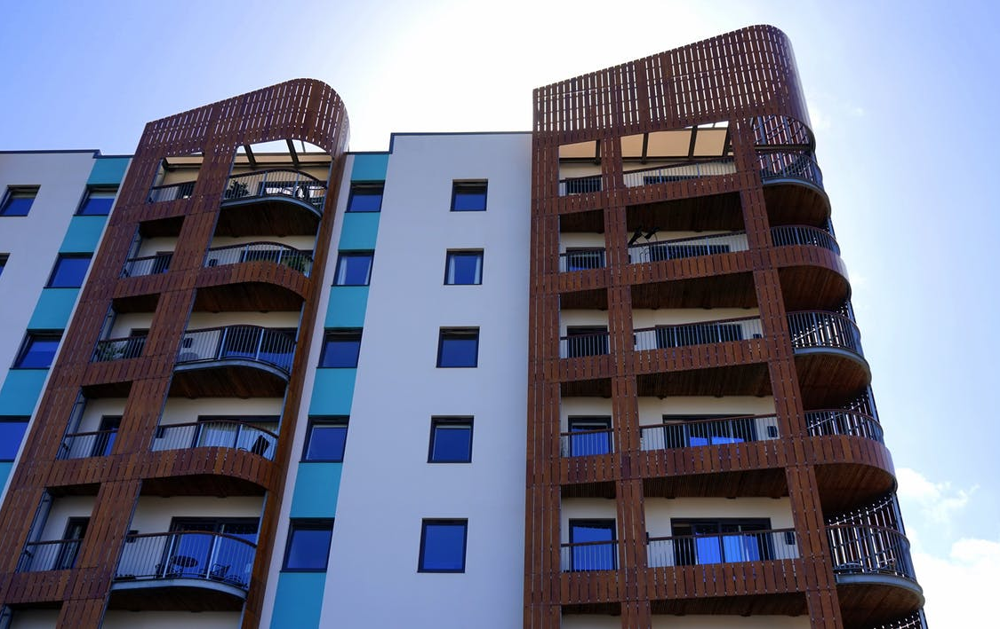
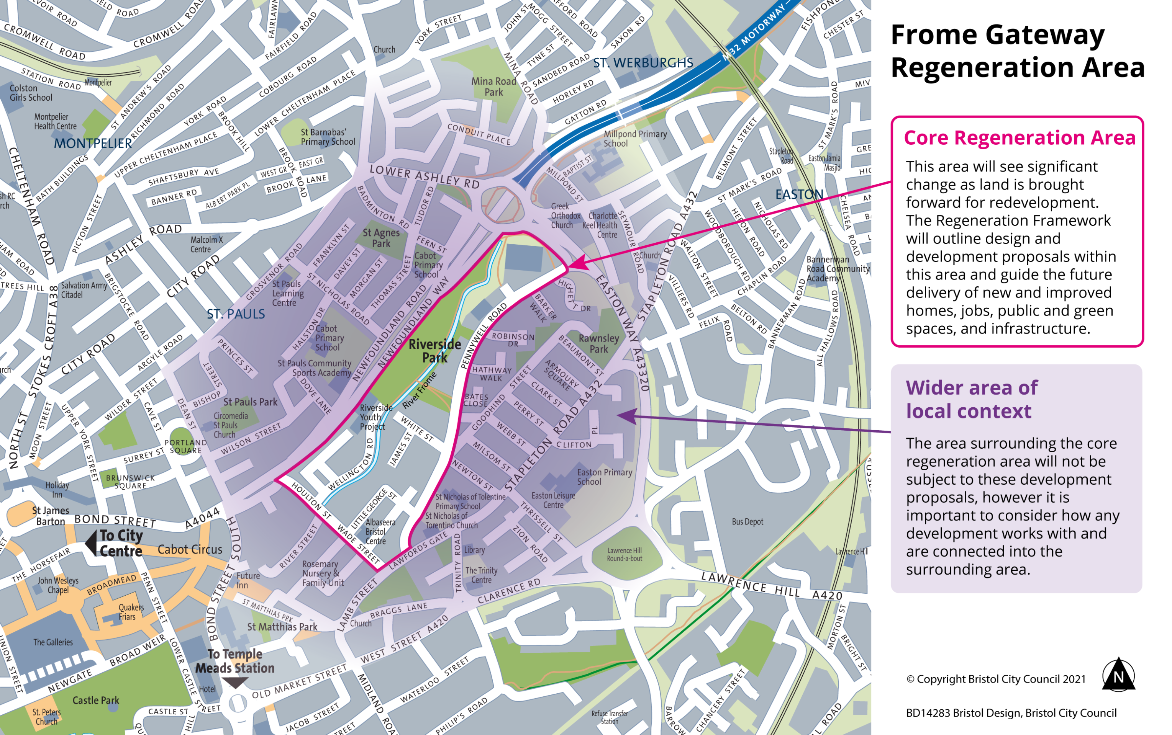
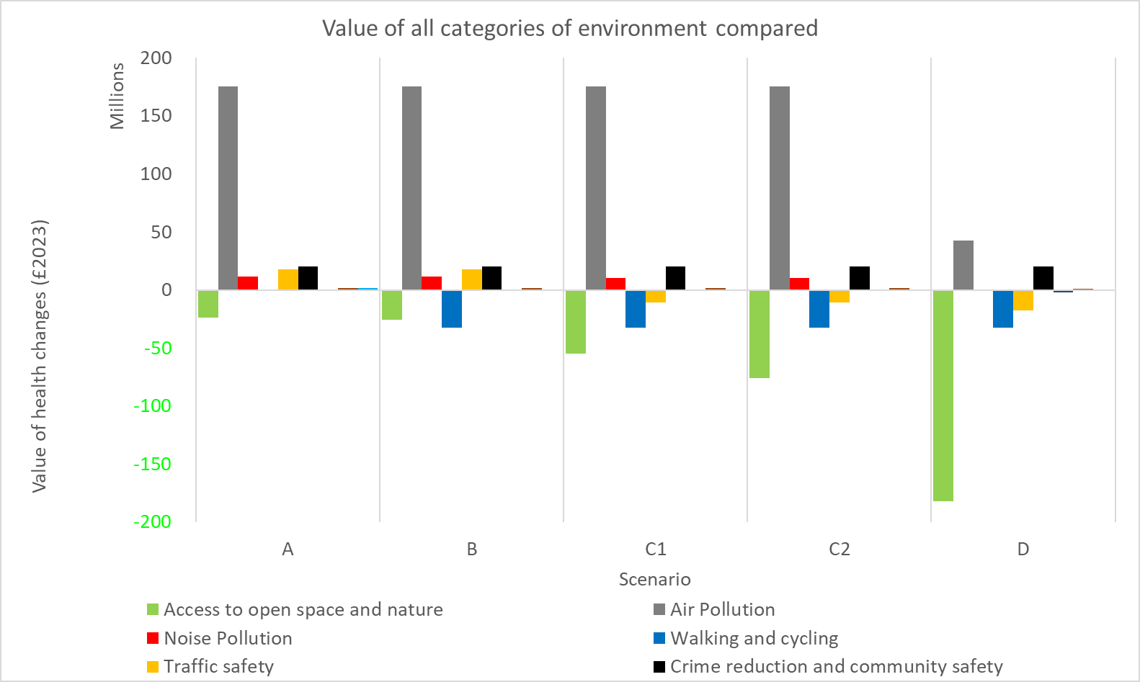
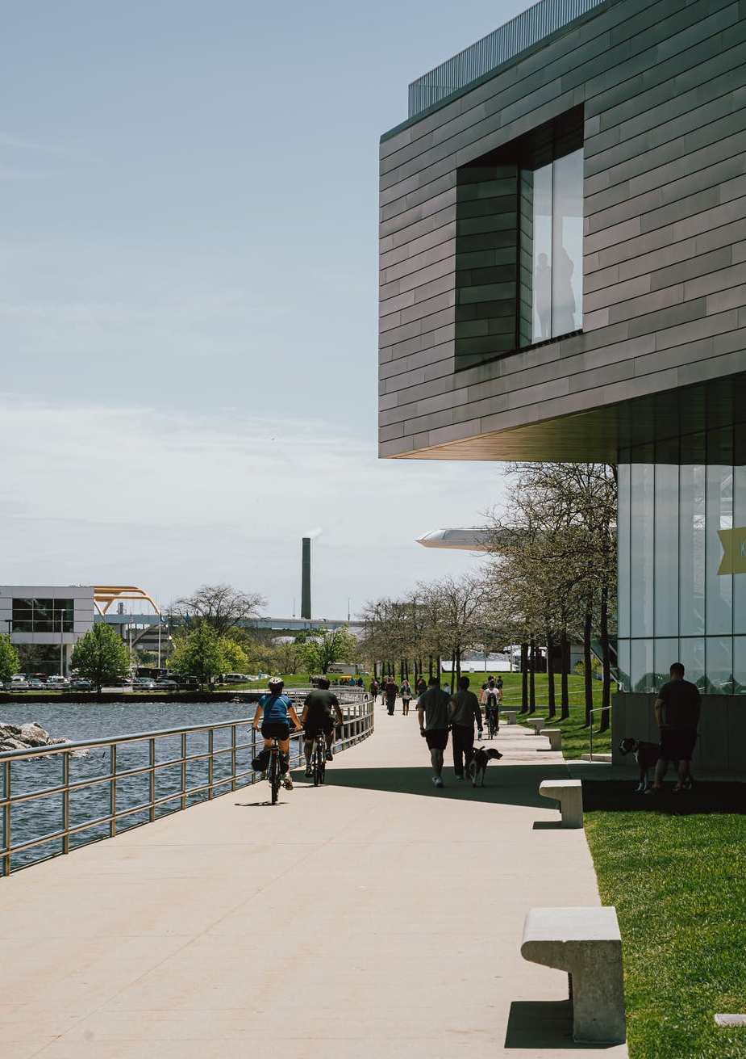
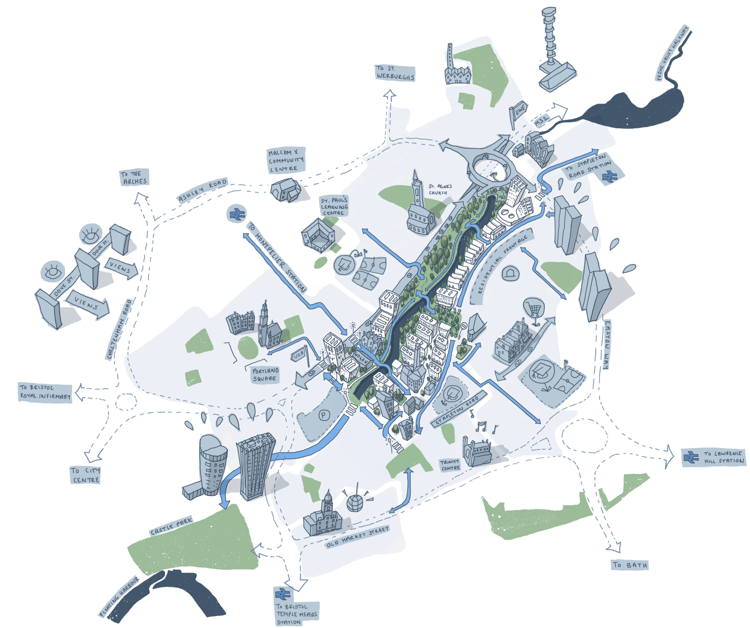
Influencing urban planning decision-making through demonstrating health impacts of changes to the built environment:
a co-designed intervention
The problem
Dr Anna Le Gouais, University of Bristol: anna.legouais@bristol.ac.uk
Eleanor Eaton, University of Bath: e.a.eaton@bath.ac.uk
TRUUD’s embedded researcher approach
Urban development decisions can influence population health and wellbeing
Physical activity
Air quality
Social interactions
Noise
Safety
Greenspaces
The TRUUD project (‘Tackling the Root Causes Upstream of Unhealthy Urban Development’) aims to understand how health is included in the complex system of urban development and develop interventions to influence healthier place-making.
Academic research
Researcher-in-Residence
Local government practice
Embedded research within local government (October 2020 – present) enables data collection, knowledge brokerage, networking and facilitation with policy-makers and practitioners.
Learning
But design decisions involve trade-offs with multiple aims and competing priorities. Decision-making processes can be opaque, making it difficult to identify leverage points to enable creation of healthy environments.
Knowledge sharing
Networking for co-produced interventions
Le Gouais A, Peake-Jones S. Researchers-in-Residence to facilitate co-production: the TRUUD project. Perspectives in Public Health. 2022;142(4):193-195. doi:10.1177/17579139221103183
Co-designing the intervention
Embedded research within a Regeneration team in local government, developing a spatial regeneration framework. The framework guides future development for over 1000 new homes and 500 student units in an existing industrial/warehouse area.
Participant-observations of meetings enabled identification of opportunities to use health data to influence decision-making for the framework.
Evaluation of potential health impacts with four urban development approaches:
The HAUS model
Modelled health economic impacts of urban development scenarios
The HAUS tool (‘Health Appraisal for Urban Systems’) was piloted in this co-produced intervention. It combines epidemiological evidence with economic valuation to estimate health and health economic impacts of environmental change.
Costs
Frome Gateway vision
Benefits
1. Unmanaged approach
2. Minimum policy compliant
3a. Strategic approach – Multiple small pocket parks
3b. Strategic approach – Single larger park
4. Ideal conditions
Reflections & follow-on work
Co-designed approach enabled timely research outputs for decision-makers. It helped to focus attention on health issues and gain political support for new greenspaces.
We used the health and health economic evidence to inform a Health Impact Assessment of the spatial regeneration framework. This provides recommendations for future planning applications within the regeneration area.
(Image: Allford Hall Monaghan Morris)

