Slide 1
System Workshop Findings
Neil Carhart
Pablo Newberry
Thanks to Ges and Rosalie for Workshop Facilitation Support
Thanks to Andy, Jo and Anna for leading on Community Engagement Workshop
Thanks to Kathy and Rain for support on methods

Slide 2
1. Workshop Findings
2. Interview Data Modelling

Slide 3
1. Workshop Findings
1
Phase 1
Phase 2
Systems Maps produced
through Group Model Building
(see Appendix B)
Provisional Systems Maps
Group Model Building Workshops
Intervention Development Phase
(additional interviews & detailed systems mapping as required in co-development of specific interventions)
2
Informs
Systems Maps extracted
from transcripts
WP1
Stakeholder Identification & Interview Process
Uncoded Transcripts
Coded
Transcripts
Coded Transcript Analysis
Identification of Potential Intervention Areas
Informs
3
Coded System Maps
Systems Maps extracted
from thematic coding (see Appendix C)
Informs
2. Interview Data Modelling
Notes:
This is a slide that WP1 would have seen in a meeting back in October last year taken from a methods document that outlines what we are doing with Systems Mapping.
Essentially the original plan was to produce maps from coded transcripts and use these to inform some external workshops. We pivoted initially to use uncoded transcripts first to bring the workshops to run in parallel with ongoing interviews.

Slide 4
What we said we would do in the proposal
18 “systems mapping focus groups” over the life of the project (6 people per workshop)…
“to enable co-produced visual mapping of systems, and evaluate how well the proposed system changes have been implemented and any resultant outcomes.”
“We will make explicit and visual the otherwise implicit mental models regarding the causal relationships between the key factors”
Notes:
6 in Phase 1 data gathering (actually we geared it more front loaded in the proposal), 6 in Phase 2 (intervention design) and 6 in Phase 3 (intervention implementation/evaluation).
These are also intended to support the actions of other Work Packages or activities as required.
36 people in Phase 1 (6 workshops with 6 people)
“implicit mental models” – that includes where people’s mental models are wrong

Slide 5
4 Events
Small Sample
20th October (General Focus)
28th October (General Focus)
6th December (Industry Focus)
Organised by Rosalie Callway & Green Building Council
8th December (Citizen Engagement Focus)
Organised by Jo White & Anna Le Gouais
47 Participants
15 Local Government
3 Health
16 Local Communities
13 Private Sector
Notes:
Tried to have two more general ones but ended up being cancelled for various reasons.
Manchester not represented. Will go back to once we have refined messaging about intervention areas.
Start with first three which essentially followed the same format.

Slide 6
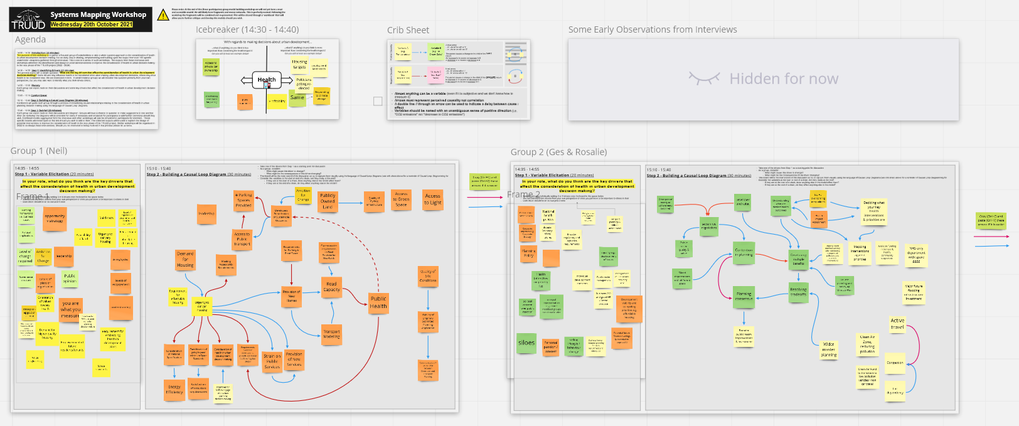

Slide 8
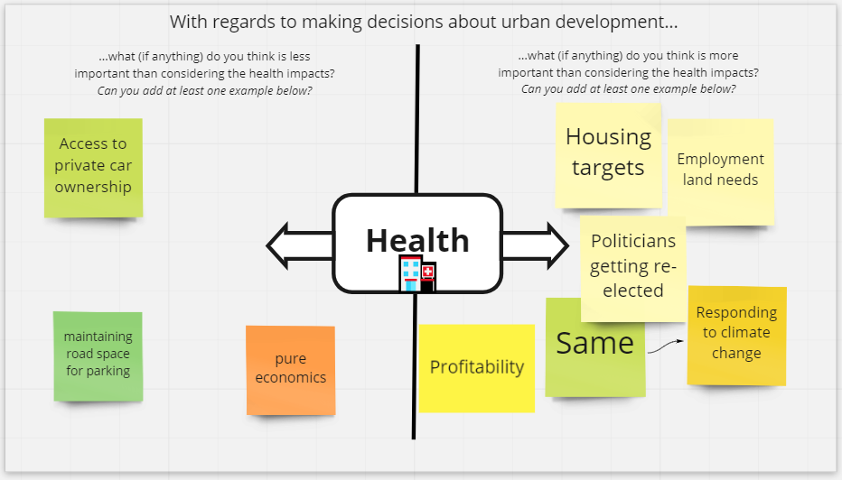
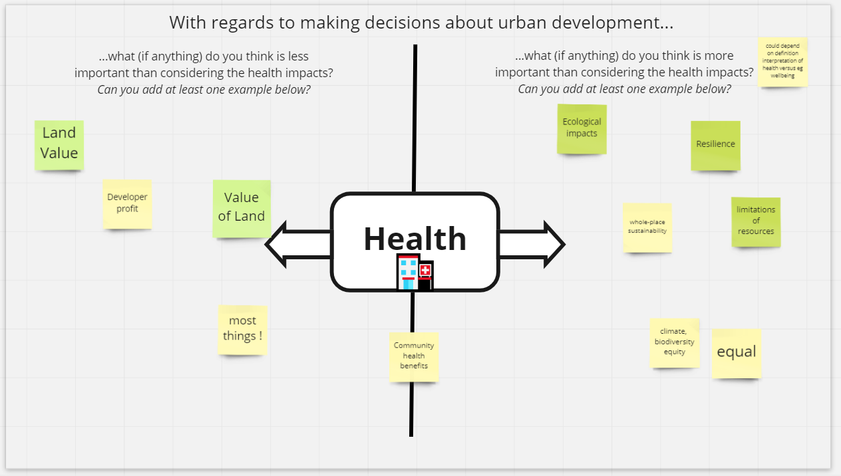
As an icebreaker participants were asked to place a post-it note identifying things they considered to be more important and less important to consider then health when making decisions regarding urban development.
There was no suggested or implied scale or suggestion that further from the central axis had any specific meaning, but some may have interpreted it this way.
20th October
Less important to consider |  |  | HEALTH | More important to consider
Access to private car ownership | Value of Land* | Pure Economics |  | Profitability** | Housing targets | Employment land needs
Maintaining road space for parking | Most things! |  |  | Ecological impacts | Politicians getting re-elected | Responding to climate change
Land Value* |  |  |  |  | Whole place sustainability | Resilience
Developer profit** |  |  |  |  | Climate, biodiversity, equity | Limitations of resources
 |  |  |  |  |  | Equal
28th October
Additional comment: “could depend on definition interpretation of health vs e.g. wellbeing”

Slide 9
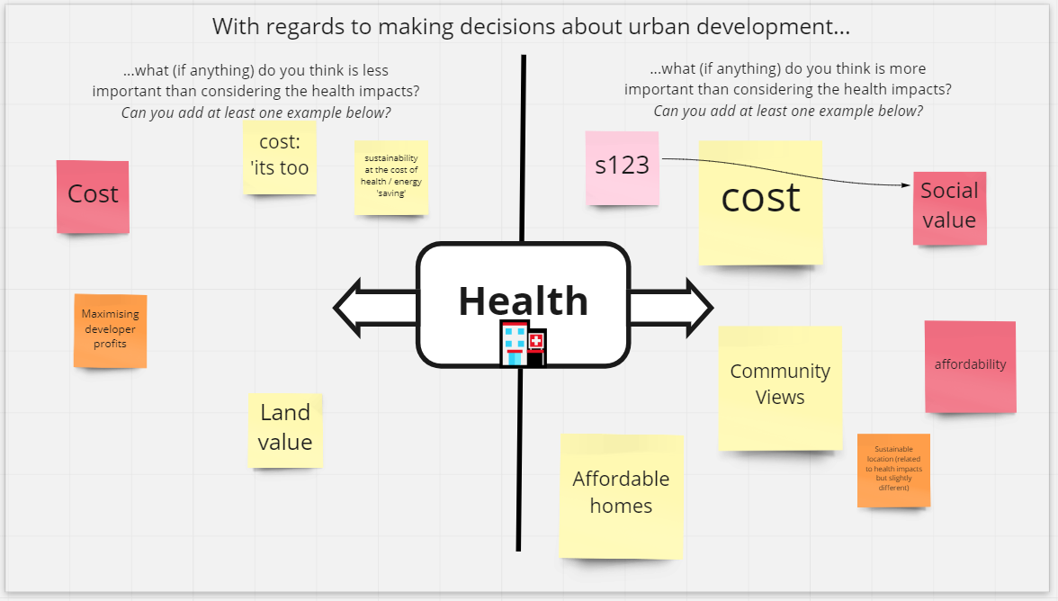
Less important to consider |  |  | HEALTH | More important to consider
Access to private car ownership | Value of Land* | Pure Economics |  | Profitability** | Housing targets | Employment land needs
Maintaining road space for parking | Most things! | Sustainability at the cost of health/energy saving |  | Ecological impacts | Politicians getting re-elected | Responding to climate change
Land Value* | Cost^ |  |  | S123 | Whole place sustainability | Resilience
Developer profit** | Land Value* |  |  | Affordable Homes | Climate, biodiversity, equity | Limitations of resources
Cost^ |  |  |  |  | Cost^ | Equal
Maximising developer profits** |  |  |  |  | Community Views | Social Value
 |  |  |  |  |  | Affordability
 |  |  |  |  |  | Sustainable location
6th December (Industry Roundtable)

Slide 10
With regards to making decisions about urban development…
As an icebreaker participants were asked to place a post-it note identifying things they considered to be more important and less important to consider then health when making decisions regarding urban development.
There was no scale or suggestion that further from the central axis had any specific meaning, but some may have interpreted it this way so their interpretation is loosely preserved but should be taken with this caveat.
Unambiguous duplication has been removed except where the same terms were used on both sides. These are highlighted in red. Otherwise the wording of the participants has been preserved.
Orange cells represent distinct contributions from the industry roundtable.
What does “Equal” mean in this context?
…what (if anything) do you think is less important than considering health impacts? |  |  | HEALTH | …what (if anything) do you think is more important than considering health impacts?
Access to private car ownership | Value of Land | Pure Economics |  | Profitability | Housing targets | Employment land needs
Maintaining road space for parking | Most things! | Sustainability at the cost of health/energy saving |  | Ecological impacts | Politicians getting re-elected | Responding to climate change
Profitability | Cost |  |  | S123 | Whole place sustainability | Resilience
 |  |  |  | Affordable Homes | Climate, biodiversity, equity | Limitations of resources
 |  |  |  |  | Cost | Equal
 |  |  |  |  | Community Views | Social Value
 |  |  |  |  |  | Affordability
 |  |  |  |  |  | Sustainable location

Slide 11
1. Meeting affordable housing targets are viewed as a more important consideration than health.
2. Addressing sustainability and climate change issues are viewed as a more important consideration than health.
3. There is disagreement over whether cost and profitability are more important considerations than health
Notes:
People may be putting their perceptions of what others think is important
They may be saying what is done, but that doesn’t mean they think that is correct or ideal (if it isn’t profitable it isn’t viable)

Slide 12
Next participants were asked…
in your role, what do you think are the key drivers that affect the consideration of health in urban development decision making?
Some of the responses imply ‘drivers' was interpreted quite loosely.
The process was adapted to fit the reduced time for the industry roundtable (see next slide).
1 | Cost to Developer |  | 24 | Consideration of Qualitative Lived Experiences
2 | Developer Profits |  | 25 | Existing Health Needs/Inequalities
3 | Cost to Society |  | 26 | Governance Structure
4 | Potential Future Savings |  | 27 | Organisational Culture
5 | Value Engineering |  | 28 | Organisational Strategy
6 | Access to Funding |  | 29 | City Vision
7 | Availability of Land |  | 30 | Value Towards Health
8 | Viability of Development |  | 31 | Collaboration
9 | Availability of Skills & Expertise |  | 32 | Organisational Siloes
10 | Political Implications |  | 33 | National Health Policies
11 | Requirements for Affordable Housing |  | 34 | Planning Policies
12 | Demand for Higher Quality Housing |  | 35 | Regulatory Requirements
13 | Quality of Leadership |  | 36 | Enforcement of Regulations
14 | Scale of Change Required |  | 37 | Poverty
15 | Ambition for Change |  | 38 | Equality/Inequality
16 | Timescales for Change |  | 39 | Demographics
17 | Public Opinion |  | 40 | Environmental Health
18 | Level of Engagement with Public |  | 41 | Management of Public Realm
19 | Equality of Engagement with Public |  | 42 | Quality of Healthcare Infrastructure
20 | Empowerment of Residents |  | 43 | Incentives for NHS to Engage
21 | Informed & Active Public |  | 44 | Individual Development Consents
22 | Appropriateness of Data |  | 45 | Responsibility
23 | Availability of Data |  | 46 | Influence on Developers
112
drivers initially offered by participants across both general workshops
46
grouped and consolidated drivers from general workshops
It is not immediately apparent what some of these terms (e.g. City Vision, responsibility) offered by the participants mean in this context. Retained here for completeness.
Notes:
INSTRUCTIONS
Font should be set to Arial throughout the presentation.
Content slide headings should be font size 36.
Body text should be set to font size 18.
To add/remove or adjust the positioning of logos, go to ‘View’, then ‘Slide Master’ and edit here. Please note the changes made in the Slide Master will apply throughout the presentation. Ensure an original copy of the Powerpoint is kept safe.

Slide 13
At the industry-focused event participants were not specifically asked the question as a separate step, but nevertheless identified factors which affected the extend to which health was considered in urban development decision making as part of the subsequent activity.:
Cost
Return on Investment
Budget Myopia
Investors
Contractors
Developers
HM Treasury
Other Government Departments
Local Authorities
Availability of Skills & Expertise
Awareness of Health-Built Environment Nexus
Voters
Requirements for Affordable Housing
Building Efficiency Requirements
Leadership
Space Requirements
Level of Placemaking
Section 123 Local Governments Act
Level of Engagement with Public
Performance Specification
Informed & Active Public
Land Owner Incentives
Developer Incentives
Biodiversity
Land Value
Priority of Local vs Wider Needs
Level at Which Decisions are Made
Regional Strategy
Consideration of Health in Design
Value Towards Health
Collaboration
Review Panels
Focus on Climate
Regulatory Requirements
Flexibility of Requirements
Wider Asset Provision Requirements
77
drivers initially offered by participants in industry workshop
36
grouped and consolidated drivers from general workshops
Those highlighted in red indicate terms drivers which appeared in both lists.

Slide 14
Both lists have been consolidated and grouped here to produce a list of factors/issues which affect the extent to which health is considered in urban development decision making..
Cost to Developer
Return on Investment
Cost to Society
Budget Myopia
Potential Future Savings
Value Engineering
Access to Funding
Land Value
Viability of Development
Availability of Land
Investors
Contractors
Developers
HM Treasury
Other Government Departments
Review Panels
Local Authorities
Voters
Political Implications
Developer Incentives
Land Owner Incentives
Availability of Skills & Expertise
Awareness of Health-Built Environment Nexus
Appropriateness of Data
Availability of Data
Requirements for Affordable Housing
Demand for Higher Quality Housing
Building Efficiency Requirements
Performance Specification
Public Opinion
Level of Engagement with Public
Empowerment of Residents
Informed & Active Public
Equality of Engagement with Public
Consideration of Qualitative Lived Experiences
Level of Placemaking
Level at Which Decisions are Made
Priority of Local vs Wider Needs
National Health Policies
Governance Structure
Organisational Culture
Organisational Strategy
Regional Strategy
City Vision
Quality of Leadership
Responsibility
Management of the Public Realm
Scale of Change Required
Timescales for Change
Ambition for Change
Consideration of Health in Design
Value Towards Health
Quality of Healthcare Infrastructure
Collaboration
Incentives for NHS to Engage
Organisational Siloes
Regulatory Requirements
Section 123 Local Governments Act
Space Requirements
Flexibility of Requirements
Enforcement of Requirements
Individual Development Consents
Wider Asset Provision Requirements
Poverty
Equality/Inequality
Existing Health Needs/Inequalities
Demographics
Focus on Climate
Environmental Health
Biodiversity
Housing
reqRMNTS
HEALTH
Cost & Value
COLLAB
Public
engagement
REGULATIONS &
REQUIREMENTS
.
Stakeholders &
Stakeholder implications
Governance
Wider Contextual
Factors
SKILS &
Knowledge
CHANGE
Notes:
INSTRUCTIONS
Font should be set to Arial throughout the presentation.
Content slide headings should be font size 36.
Body text should be set to font size 18.
To add/remove or adjust the positioning of logos, go to ‘View’, then ‘Slide Master’ and edit here. Please note the changes made in the Slide Master will apply throughout the presentation. Ensure an original copy of the Powerpoint is kept safe.

Slide 15
Key Drivers
1 | Regulatory Requirements (12)
2 | Availability of Skills & Expertise (9)
3 | Level of Engagement with Public (8)
=3 | Enforcement of Regulations (8)
=3 | Developer Profits (8)
6 | Cost to Developers (7)
7 | Appropriateness of Data (4)
=7 | Availability of Data (4)
=7 | Consideration of Qualitative Data (4)
=7 | Existing Health Inequalities (4)

Slide 16
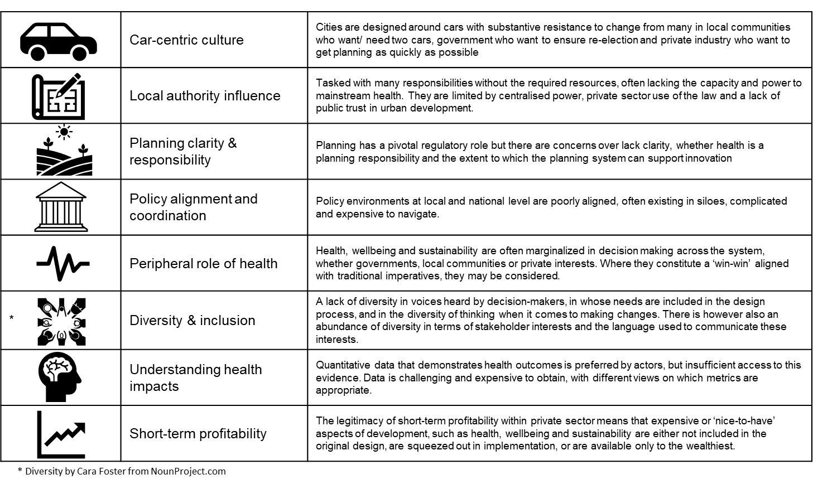
Stakeholder Influences
Governance
Regulations
Housing Requirements
Collaboration
Contextual Factors
Public Engagement
Skills & Knowledge
Change
Cost & Value

Slide 17
1. Many factors are driving the consideration of health
2. Agreement over key drivers: (i) Regulatory Requirements, (ii) Skills & Expertise to Consider Health, (iii) Engagement with Public, (iv) Cost/Profit and (v) Quality & Availability of Data
3. Drivers align with TRUUD Structure and WP1 findings
Notes:
1 and therefore health is in competition with those targets

Slide 18
+
+
R
B
Road
Crossings
Eggs
Chickens
+
-
(Sterman, 2000)

Slide 19
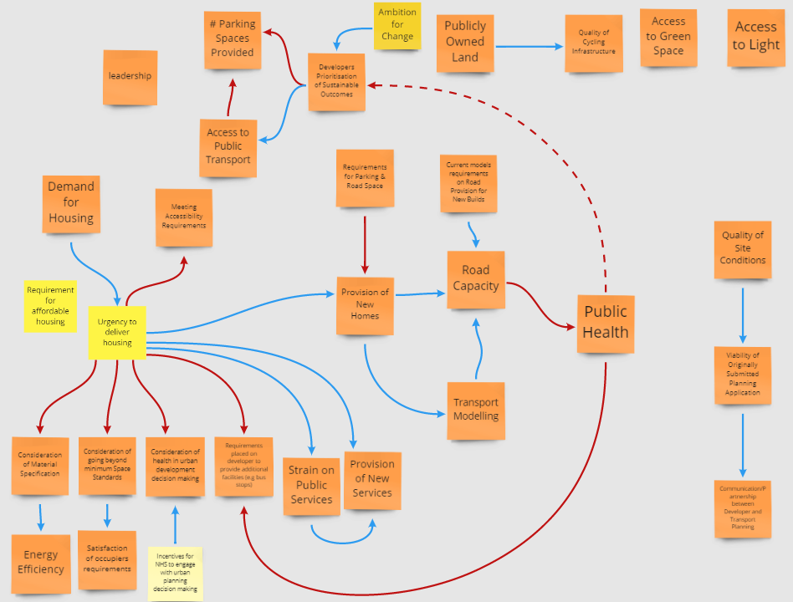
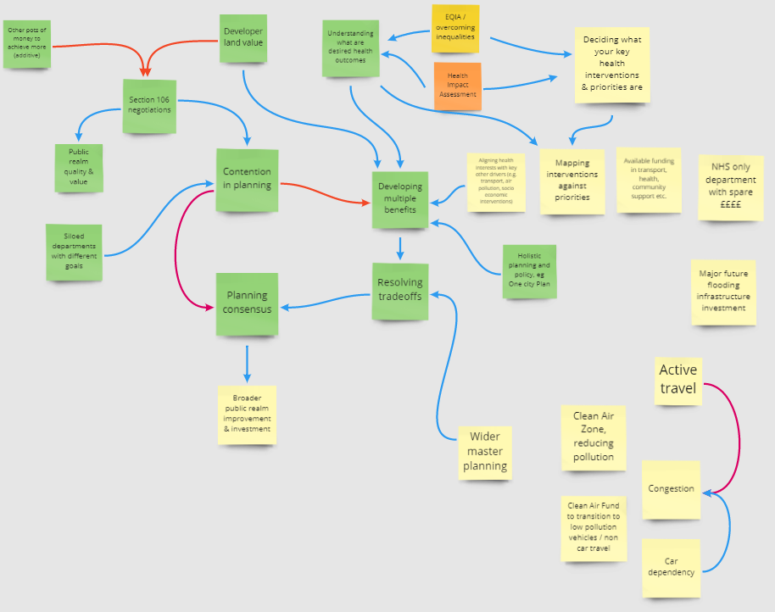
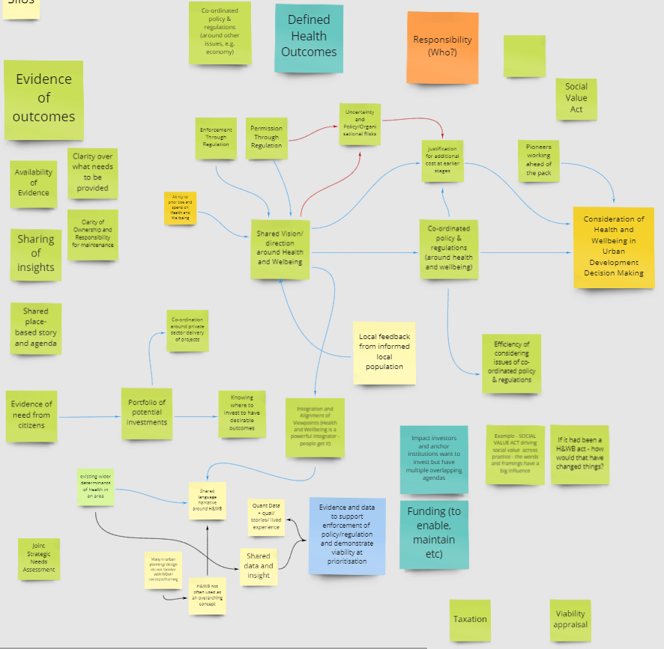
Next participants were asked to consider the ways in which these drivers interact to influence the extent to which health is considered in urban development decision making. In doing so, additional factors were added.

Slide 20
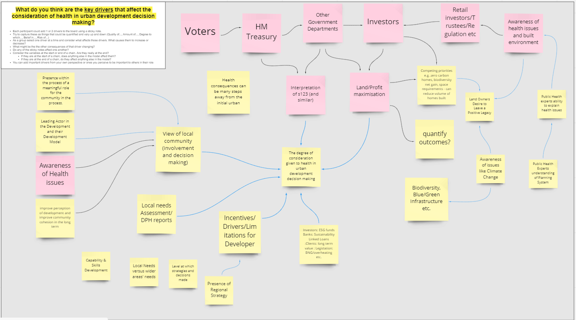
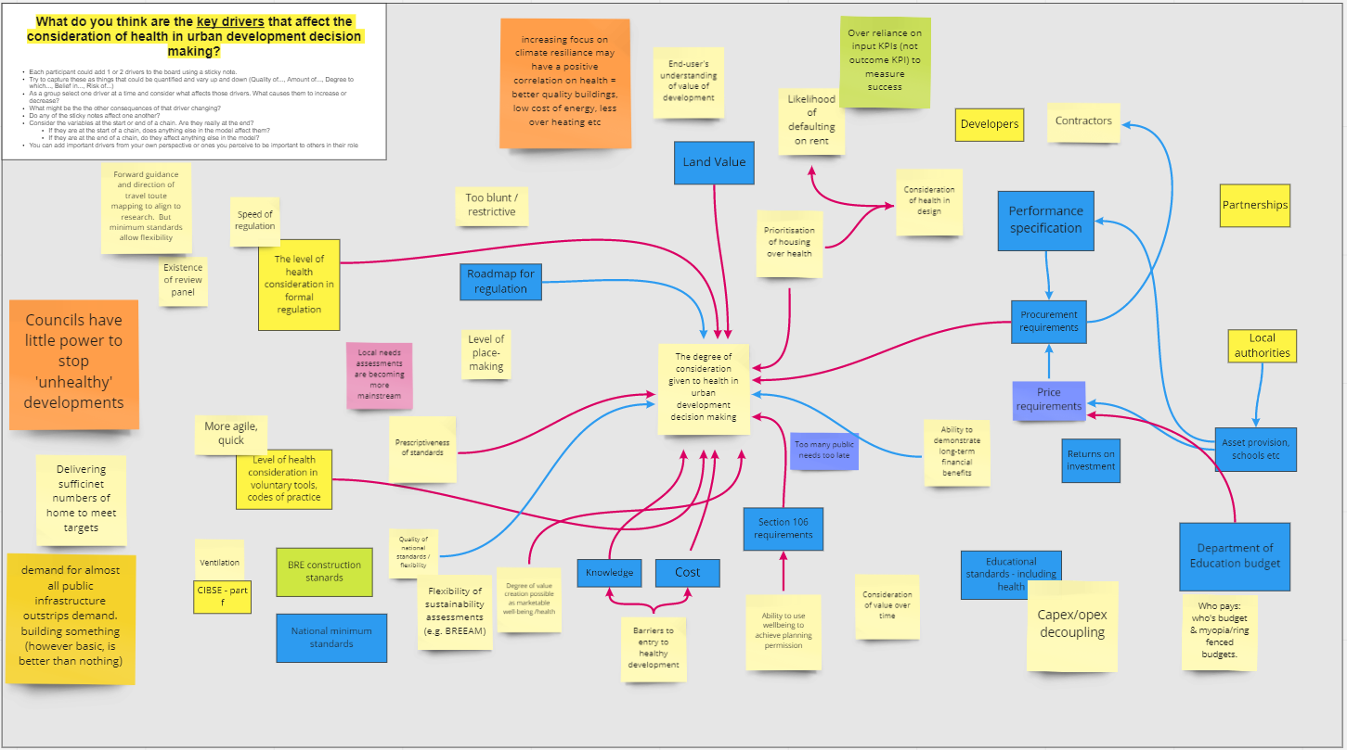

Slide 21
Quality of Consideration of Health in Urban Development Decision Making
Factors which determine the ‘Quality of Consideration of Health in Urban Development Decision Making’
Factors which directly affect the ‘Factors which determine ‘Quality of Consideration of Health in Urban Development Decision Making’
Notes:
Causally upstream factors (things in the outer ring) may be viewed as procedurally downstream. I.e things that happened on a previous experience can have an impact on the consideration of health moving forwards.
Assumption that higher quality consideration of health results in better health outcomes

Slide 22
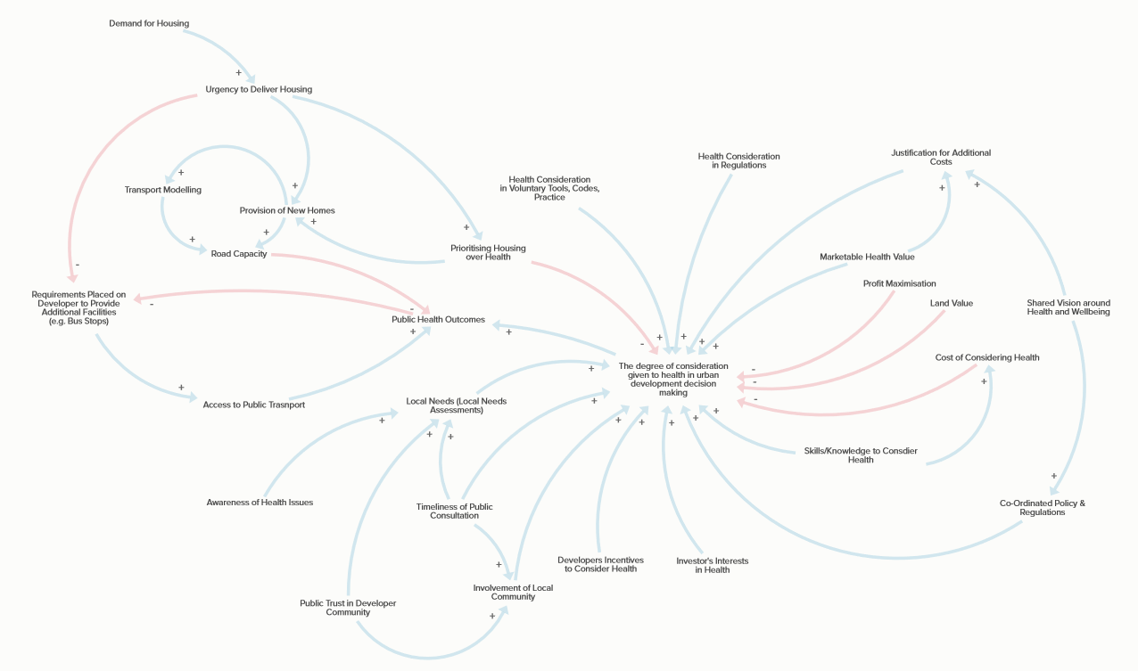
Notes:
Dive in to detail of those
On reflection, a better process now would be to take the identified drivers, model potential links as an internal research exercise and reflect back to external workshop as in Citiizen Engagement Workshop.

Slide 23
Citizen
Engagement
Workshop
Notes:
Jo and Andy have already talked about this.

Slide 24
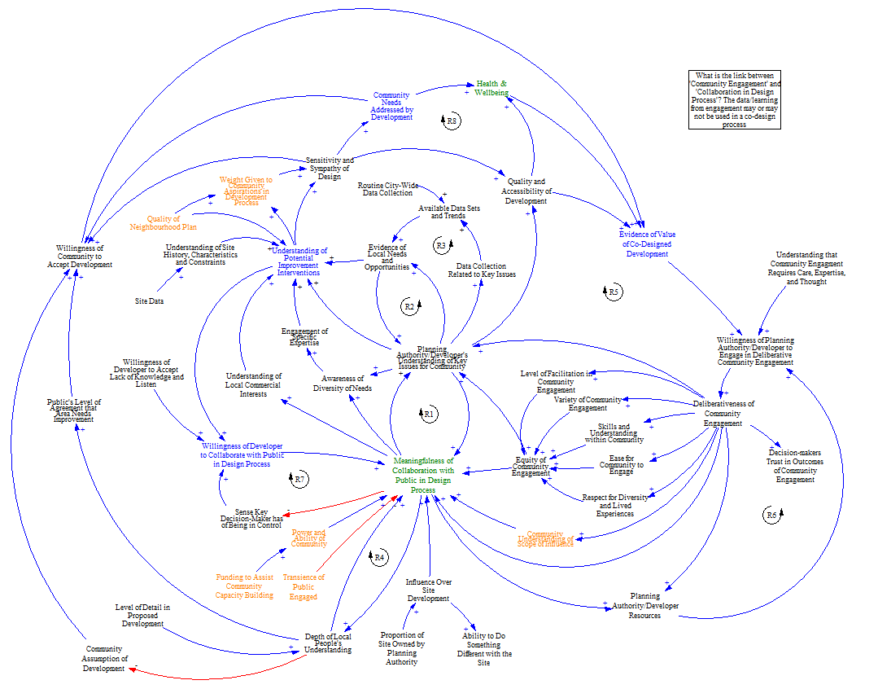
Pablo extracted all causal statements from interview transcript elements tagged relating to ‘Co-Design-Production-Delivery’ resulting in this model.

Slide 25
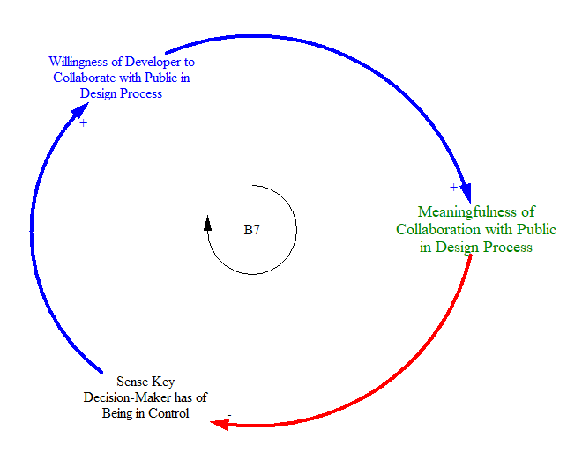
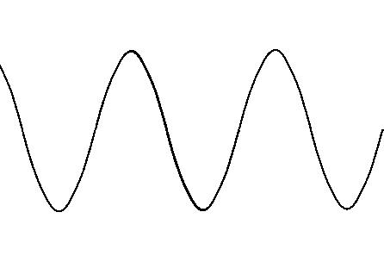
Meaningfulness of Collaboration with Public in Design Process
Sense Key Decision-Maker has of Being in Control
Willingness of Developer to Collaborate with Public in Design Process
Meaningfulness of Collaboration with Public in Design Process
Meaningfulness of Collaboration with Public in Design Process
Sense Key Decision-Maker has of Being in Control
Willingness of Developer to Collaborate with Public in Design Process
Meaningfulness of Collaboration with Public in Design Process
Notes:
Manually extracted from all interview data tagged with ‘Co-Design-Production-Delivery’ sub category of public involvement

Slide 26
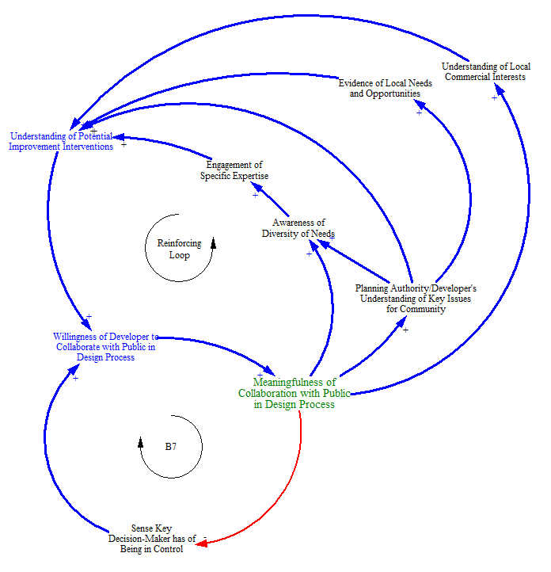
Notes:
A number of reinforcing loops countering that balance. Which is more powerful/domain? How might you change not just the variables but the strength of influence to ensure the change you want?

Slide 27
Participants first asked what (if anything) was missing from this part along with any other feedback

Slide 28
“the more people can be let in on conversations the more understanding there is, the smoother the process in my experience”
“I think you need a much broader public engagement, but also much deeper, and those are different, and they will involve different people.”
“[with respect to] an equitable conversation, and that lived experience and experience of inequity and exclusion is so, so important and powerful that we need to respect that as an expertise, and invite that to the table”
“That’s meant to be giving as many people as possible as easy a way as possible of [engaging]”
Variety of
Community Engagement
Ease for
Community to Engage
Respect for Diversity
and Lived Experience
Equity of Community
Engagement
Skills & Understanding
within Community
Level of Facilitation in
Community Engagement
“what we need is an ongoing conversation […], where communities learn about the data and the technical things, the things that are problematic, and that we upskill each other in that sense so that it’s more of an equitable conversation”
“And there’s something about how do you facilitate those conversations […] there’s something about how you create the structures for that, and then structures that decision-makers can trust”

Slide 29
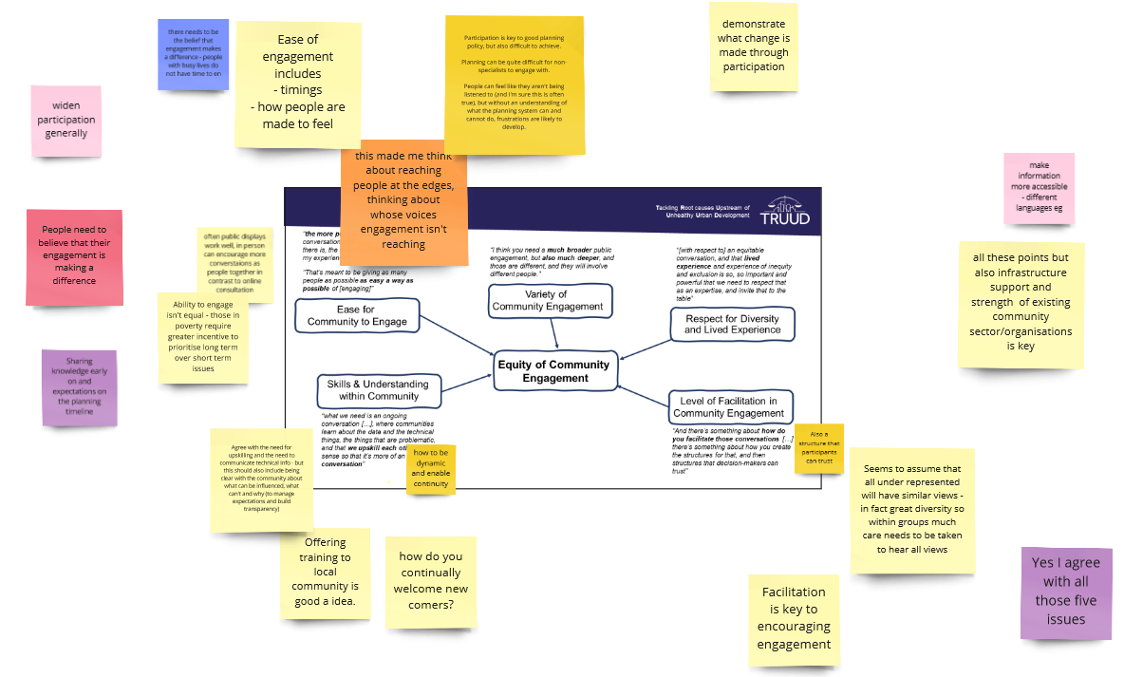

Slide 30
1 | Demonstrate what change is made through participation
2 | Participation is key to good planning policy, but also difficult to achieve. Planning can be quite difficult for non-specialists to engage with. People can feel like they aren't being listened to (and I'm sure this is often true), but without an understanding of what the planning system can and cannot do, frustrations are likely to develop.
3 | There needs to be the belief that engagement makes a difference - people with busy lives do not have time to engage
4 | Ease of engagement includes - timings - how people are made to feel
5 | Widen participation generally
6 | This made me think about reaching people at the edges, thinking about whose voices engagement isn't reaching
7 | Make information more accessible - different languages eg
8 | People need to believe that their engagement is making a difference
9 | Often public displays work well, in person can encourage more conversations as people together in contrast to online consultation
10 | All these points but also infrastructure support and strength of existing community sector/organisations is key
11 | Ability to engage isn't equal - those in poverty require greater incentive to prioritise long term over short term issues
12 | Sharing knowledge early on and expectations on the planning timeline
13 | Also a structure that participants can trust
14 | Agree with the need for upskilling and the need to communicate technical info - but this should also include being clear with the community about what can be influenced, what can't and why (to manage expectations and build transparency)
15 | how to be dynamic and enable continuity
16 | Seems to assume that all under represented will have similar views - in fact great diversity so within groups much care needs to be taken to hear all views
17 | Offering training to local community is good a idea.
18 | How do you continually welcome new comers?
19 | Yes I agree with all those five issues
20 | Facilitation is key to encouraging engagement
Demonstrating engagement makes a difference
Accessibility and Widening Participation
Earlier in Process
See WP4 Webinar from Thursday 9th December

Slide 31
Part 2
Interview Data Modelling

Slide 32
Team’s Collected Interview Transcript Summaries
Single Interview
Transcript
Thematic Coding Transcript Extracts
Manual Process
Basis for General & Industry Workshops
Basis for Citizen Engagement Workshop
Basis for ongoing intervention design
Semi-Automated
Process
Short enough to do manually
Basis for ongoing intervention design
(see next steps)
Notes:
Other models

Slide 33
Semi-Automated Process
Using the following query developed from a dictionary of casual conjunctions used in automated text analysis research…
so OR therefore OR thus OR consequently OR consequence OR hence OR result OR accordingly OR account OR because OR cause OR ground OR owing OR reason OR due OR sake OR since OR as OR why OR conclusion OR for OR "give rise" OR induce OR produce OR generate OR effect OR bring OR provoke OR arouse OR elicit OR lead OR trigger OR derive OR associate OR relate OR link OR stem OR originate OR "stir up" OR entail OR contribute OR "set up" OR "set in motion" OR conduce OR educe OR spark OR evoke OR implicate OR activate OR actuate OR kindle OR "fire up" OR stimulate OR "call forth" OR unleash OR effectuate OR "kick up" OR "give birth" OR "call down" OR "put forward" NOT "as well" NOT "as much" NOT "as many" NOT "so much" NOT "so many"
…approximately 17,000 potential causal phrases were identified in the corpus of interview transcripts
Selecting the smallest thematic node (‘Case Study Related’) for further analysis reveals around 20% (~3,400) of these are actually causal, others are non causal uses of common words like “so” and “for”.

Slide 34
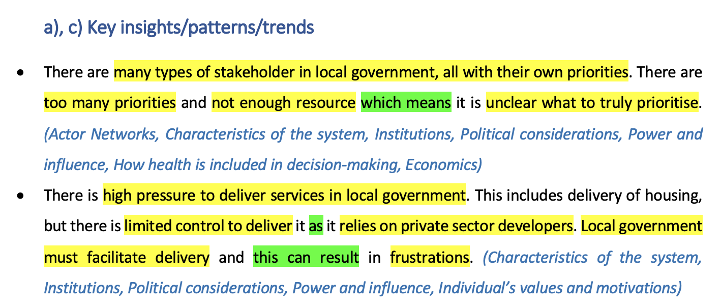
Team 2 Summary – Overall Patterns & Trends Section
Systems Mapping Phase 1 – Fragments of the System
Variables
Causal links (not always explicitly causal)
Notes:
Considered constructing systems maps from Category Summaries – lengthy process and impractical given timescales.
Overall Patterns & Trends section is the summary reduced to the key variables and interactions that emerged from the analysis.
Note: grouped variables from first bullet point.
Team 2 – Anna

Slide 35
Team 2 Summary – Overall Patterns & Trends Section
Systems Mapping Phase 1 – Fragments of the System
Notes:
Traceability back to original data

Slide 36
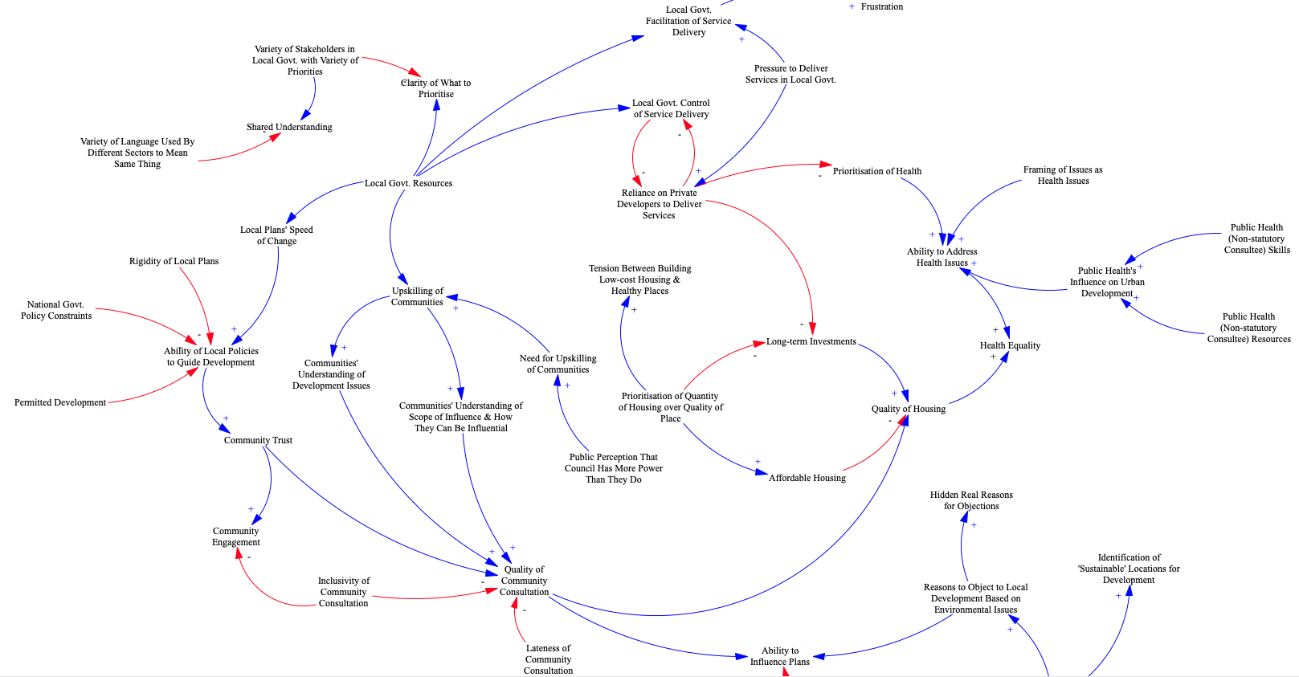
Team 2 Summary – Overall Patterns & Trends Section
Systems Mapping Phase 2 – Aggregated Systems Map
Notes:
Visualisation of system – communicates the combined mental models of interview teams/sectors to provide greater shared understanding amongst the team and use as a tool to effectively engage stakeholders.

Slide 37
Team 2 Summary – Overall Patterns & Trends Section
Systems Mapping Phase 2 – Aggregated Systems Map
Opportunity to work with teams to refine model (identify further variables and causal links, simplify/group variables, etc.) and explore significant variables/areas of the system in greater detail to improve our understanding of the system and support intervention design.
Highlights issues that are:
Upstream e.g. Framing of Issues as Health Issues
Downstream e.g. Health Equality
Potential key levers of change e.g. Local Govt. Resources
Notes:
The transcripts (and workshops) don’t tend to have any causal influences coming out of consideration of health.
Highest Degree Centrality is node with most connections to other nodes and may be a potential leverage point.

Slide 38
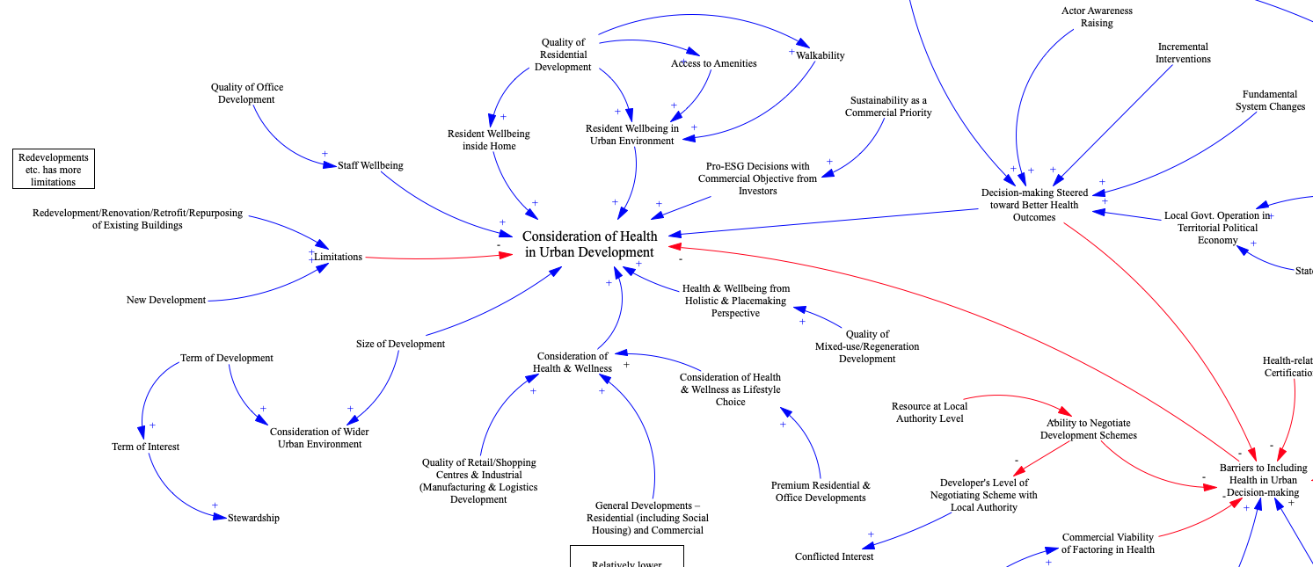
Team 5 Summary – Overall Patterns & Trends Section
Systems Mapping Phase 2 – Aggregated Systems Map

Slide 39
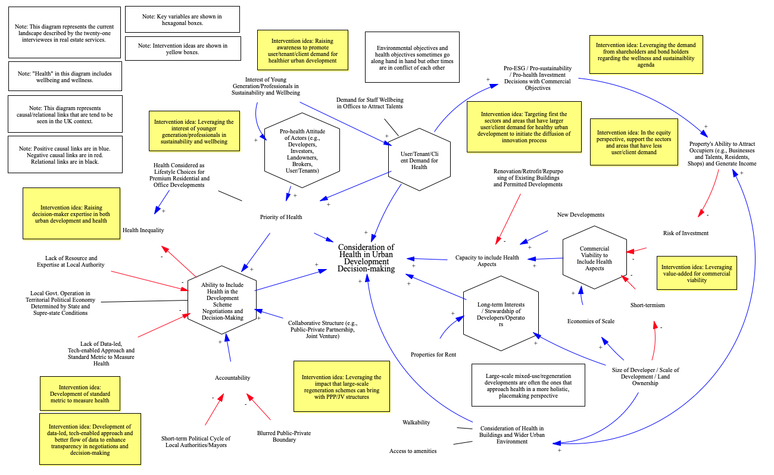
Team 5 Summary – Overall Patterns & Trends Section
Systems Mapping Phase 3 (TBD) – Refined Systems Map (First Draft)
Rain has used the aggregated systems map to develop a refined model that includes the most relevant variables based on the real estate interviews.
Rain/Kathy/Neil/Pablo meeting to discuss this process and how it ties into wider data integration.
Key
Key variables
Intervention ideas

Slide 40
Overall Conclusions
1. Housing Targets, Sustainability & Cost/Profit are key factors seen to be in competition with health consideration
2. In general key drivers of health consideration are: (i) Regulatory Requirements, (ii) Skills & Expertise to Consider Health, (iii) Engagement with Public, (iv) Cost/Profit and (v) Quality & Availability of Data
3. Many potential structural and specific leverage points in network of factors (as demonstrated by Community Engagement & Team Summary models) that can be useful to inform intervention design in Phase 2
Notes:
Initial outputs used to inform plan for March 24th to selecy intervention areas.
Detailed models ready to inform more detailed discussions of interventions once areas narrowed down.

Slide 41
Next Steps
Key drivers and emerging problem areas from the workshops are feeding into the design of the session on the 24th of March to narrow the intervention areas.
Once narrowed we look to the Team Summary models to inform more specific discussion/exploration of potential interventions (available for FCM)
Apply semi-automated process to the relevant thematically codes in interview data to extract the models related to narrowed intervention areas.
Notes:
Next Steps

Slide 42
Thanks for listening.
We’re happy to answer any questions and discuss things further.

